Slide 1
Gym Tracker
Farhan Shahbaz and Dagmawi Demess

Slide 2

Overview
Web Application helps match personal trainer with a list of clients available
For each workout session, the trainer can also chose a workout they want to perform for either one or many clients
The Application provides data for various workouts available using the wger API and search to get details on a specific workout
API: https://wger.de/api/v2/exerciseinfo/

Slide 3





Tech Stack

Slide 4
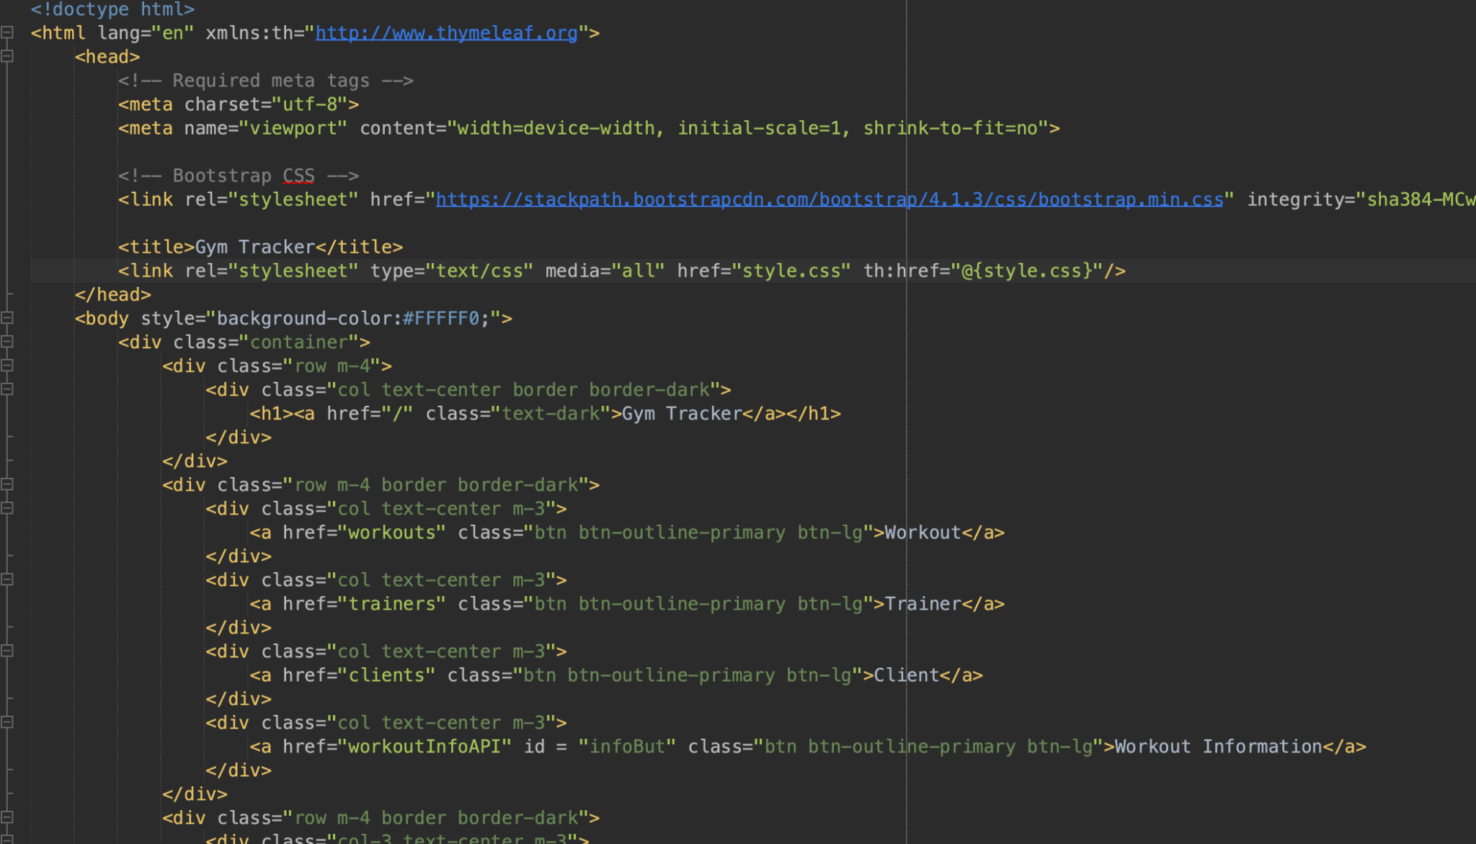
Live Demo

Slide 5
2.0
User authentication
Adding Gym locations that shows specific trainers for specific workouts
Adding Google Maps

Slide 6
Questions?

